Slide 1
Protein Pow(d)er
Programmeertheorie, Week 2, Presenteersessie 2
Team: Shire Peasants 3
Authors: Mark Dzoljic, Loek van Steijn, Sebastiaan Kruize

Slide 2
Format of the presentation
1. Introduction in the casus
State Space of the problem
2. Quick recap
3. Algorithms
Random, Greedy and more
4. Results
5. Q&A and discussion

Slide 3
1. Introduction: Stability of proteins
Proteins fulfill numerous function inside the human body
Consist of a ’string’ of amino-acids
Faulty proteins linked to diseases such as Alzheimers or huntington
Finding “Stable” Proteins can help in the development of farmaceuticals

Slide 4
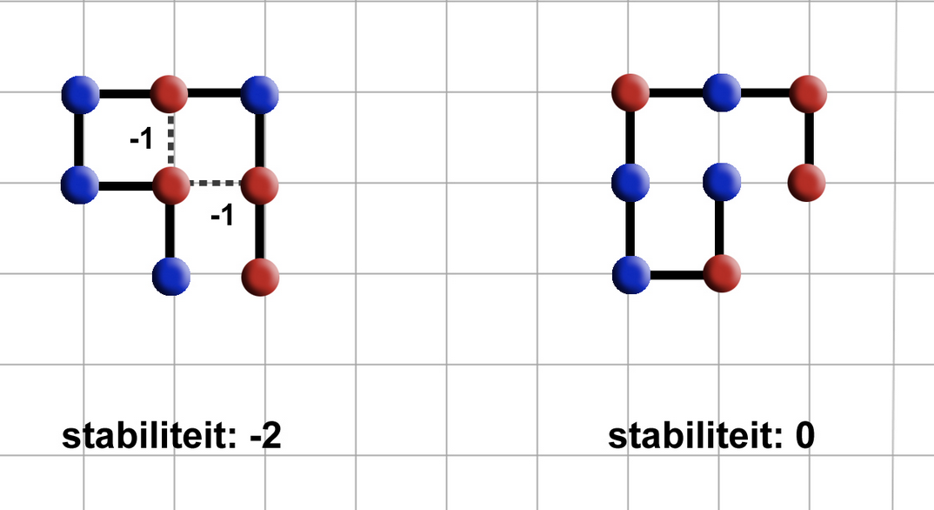
1. Introduction: Stability of proteins
Place amino-acids on a 2D-grid.
Amino acids can be hydrophic (Red) or Polair (Blue)
Red amino-acids can form bridges, and strengthen the stability
Goal is to find protein structures that are as stable as possible.

Slide 5
1. Case exploration
Constrained Optimization Problem
Constraints
Amino-acid string is given
All amino-acids must be used
Can not move ‘diagonally’ must move either left/right/up/down
Amino-acids cannot overlap
Optimization
Legitimate solution with the highest stability
State Space (2D random)
4^{n}?
4*3^{n-1}
Unchanged due to rotation
3^{n-2}
True State Space: < 3^{n-2}

Slide 6
2. Quick recap
Element Object
Stores: coordinates, direction, type
Lattice Object
Stores: element objects in Matrix or Dictionaries format
Dictionaries
Use of dictionaries to store element objects.
Matrixes (2D or 3D grid)
Use of a matrix to store element objects.
Question: which data structure is faster?

Slide 7
3. Algorithms
Tried:
Self avoiding random walk (SARW)
SARW with a twist
Greedy
Next up:
Extended Heuristic Algorithm
Breadth-first: Beam Search

Slide 8
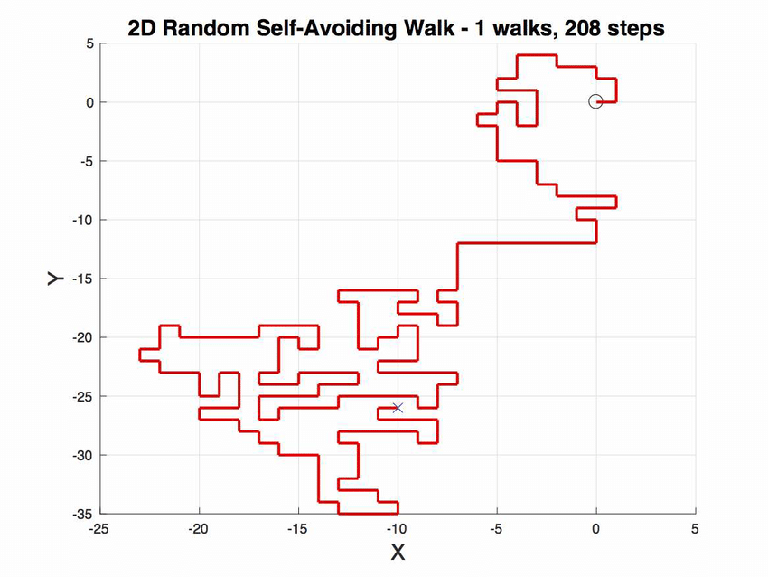
Self avoiding random walk
Let S be HP-chain of length n.
Fix first 2 elements of chain.
For subsequent elements up to the n^{th} element, choose random move from {u, d, l, r, i, o}.
If newly chosen coordinates are occupied, try new move.
Stuck? Start over.

Slide 9
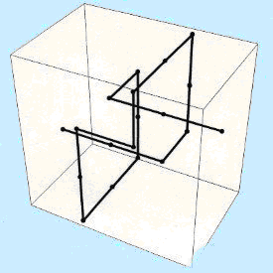
Self avoiding random walk (with a twist)
Let S be HP-chain of length n.
Fix first 2 elements of chain.
For subsequent elements up to the n^{th} element, choose random move from {u, d, l, r, i, o}.
If newly chosen coordinates are occupied, try new move.
If newly chosen coordinates are on the border, try new move.
Stuck? Start over.

Slide 10
Greedy
Let S be HP-chain of length n.
Fix first 2 elements of chain.
For subsequent elements, try all moves from {u, d, l, r, i, o} and check whether move would result in H-H connection (with self-avoidance).
If so, use the move. If not, pick random.
Stuck? Start over.

Slide 11
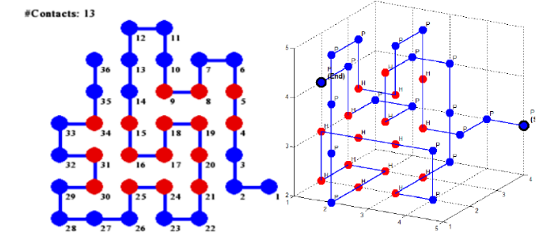
Extended Heuristic Algorithm
Divide chain S up into n parts S_{i} of predetermined length.
Fold S₁ optimally against S₀ by going through all permutations (with self-avoidance), then fold S₂ optimally against S₀ ∪ S₁, etc. up until S_{n}.
Optimal means most H-H contacts.
Source: Traykov, Metodi, et al. "Algorithm for protein folding problem in 3D lattice HP model." International Journal of Biology and Biomedicine 3 (2018).

Slide 12
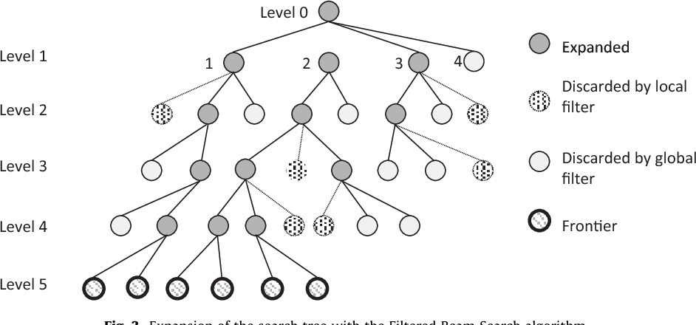
Breadth-first: Beam Search
Combination of breadth-first and greedy.
Goes through all moves from {u, d, l, r, i, o} and selects the n best moves (based on ‘beam width’).
From selected n moves, go 1 level deeper and repeat up until maximum depth.

Slide 13
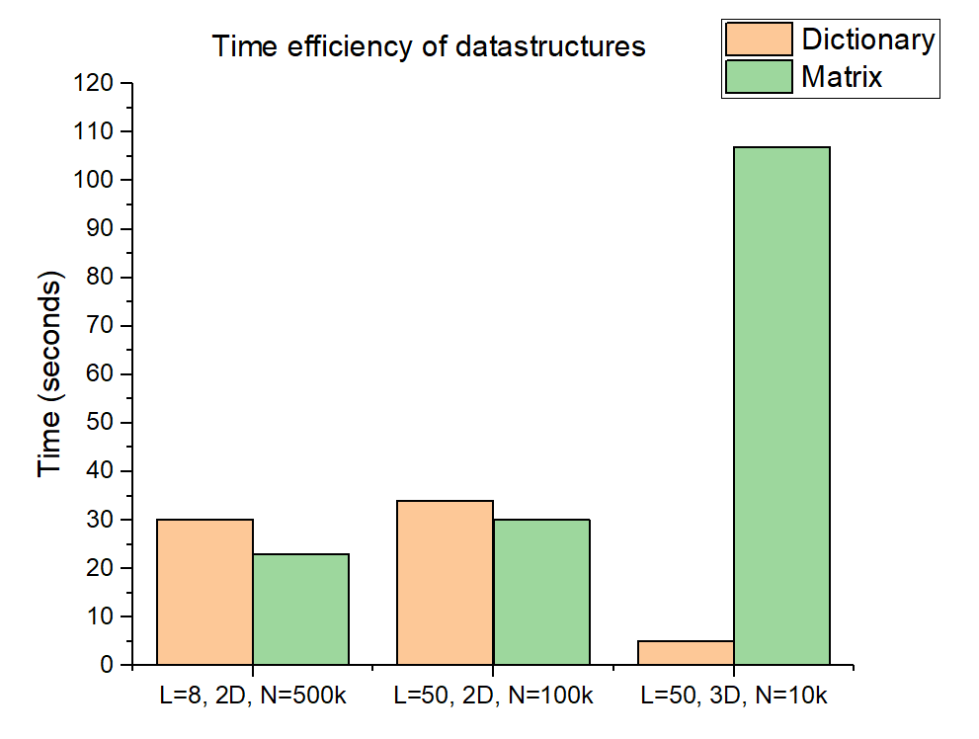
Results – Data structure
L: length of protein
N: number of iterations

Slide 14
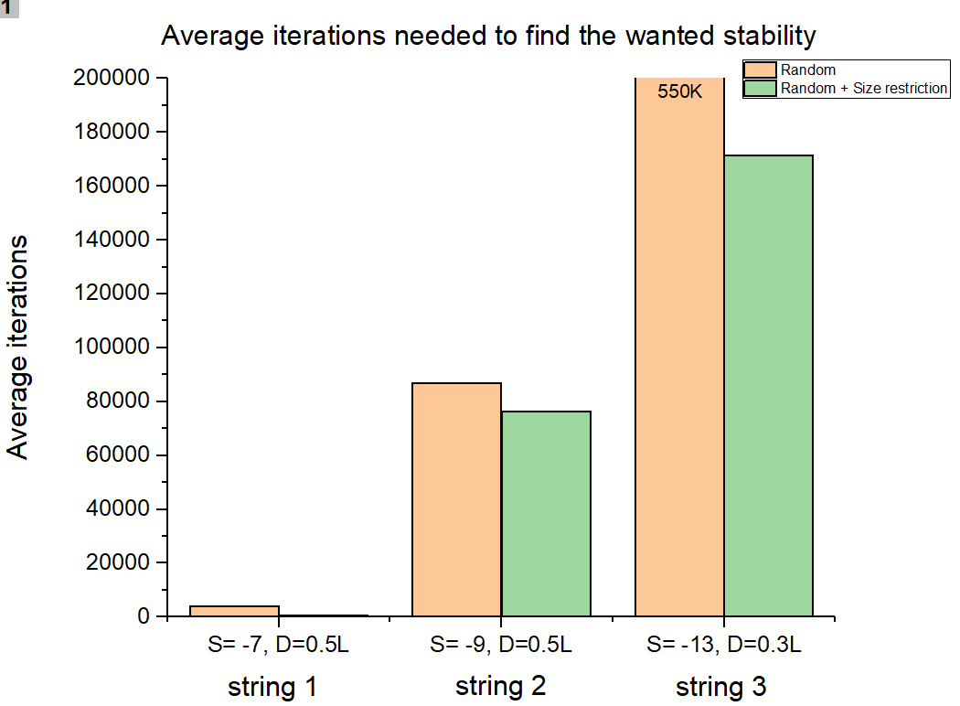
Results – Size restricted configuration
S: wanted stability
D: dimension of matrix
L: length of protein
String 1 (L=14): HHPHHHPHPHHHPH
String 2 (L=20): HPHPPHHPHPPHPHHPPHPH
String 3 (L=36): PPPHHPPHHPPPPPHHHHHHHPPHHPPPPHHPPHPP

Slide 15
Conclusions
Data structures
Size restriction
Situation | Matrix (time) | Dictionary (time) | Improvement
L=8, 2D, N=5E⁵ | 23 s | 30 s | +23%
L=50, 2D, N=1E⁵ | 30 s | 34 s | +12%
L=50, 3D, N=1E⁴ | 107 s | 5 s | -2040%
Size restriction D=0.5L | 3 s | 5 s | +40%
Situation | Random iterations | Size restricted iterations | Improvement
S=-7, L=14, D=0.5L | 4076 | 555 | +86%
S=-9, L=20, D=0.5L | 86881 | 76272 | +12%
S=-13, L=36, D=0.3L | 530253 | 171503 | +67%

Slide 16
4. Method: Possible algorithms
Name | Result | Method | Ω (Best Case) | Runtime (1000 iterations) Dict | Runtime (1000 iterations) Matrix
Random | Sub-optimal | Constructive
Greedy | Sub-optimal+ | Constructive
Lineair | Optimal | Constructive
Future | - | -

Slide 17
Questions and comments?
Our questions:
All our algorithms are ‘constructive’. Ideas where to think regarding iterative algorithms?
What is your view on our choice for datastructure?
Thank you for your attention

